Slide 1
Nipah Virus Phosphoprotein Evolutionary Selection Analysis

Slide 2
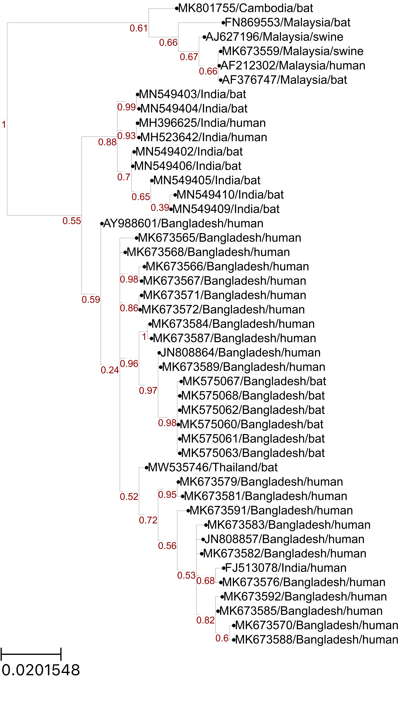
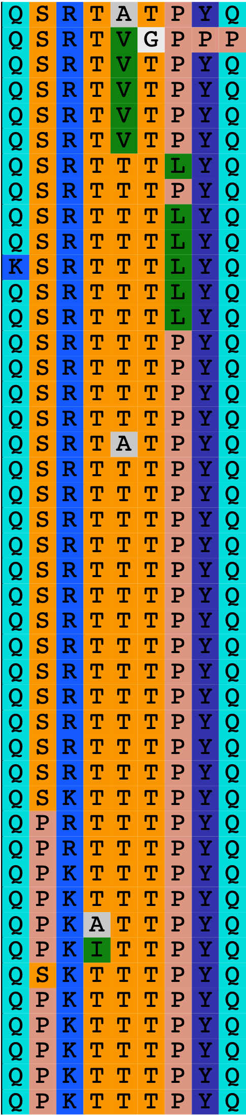
Amino Acids under Positive Selection
Malaysia
India
Bangladesh
Notes:
FEL also identified site 380
Not sure how to use the Empirical Bayes Factor to help with analyses. Provides a confidence measure of whether diversification occurred in a given branch? The paper seems to mention EBF values > 1, but the table outputs proportions between 0 and 1.

Slide 3
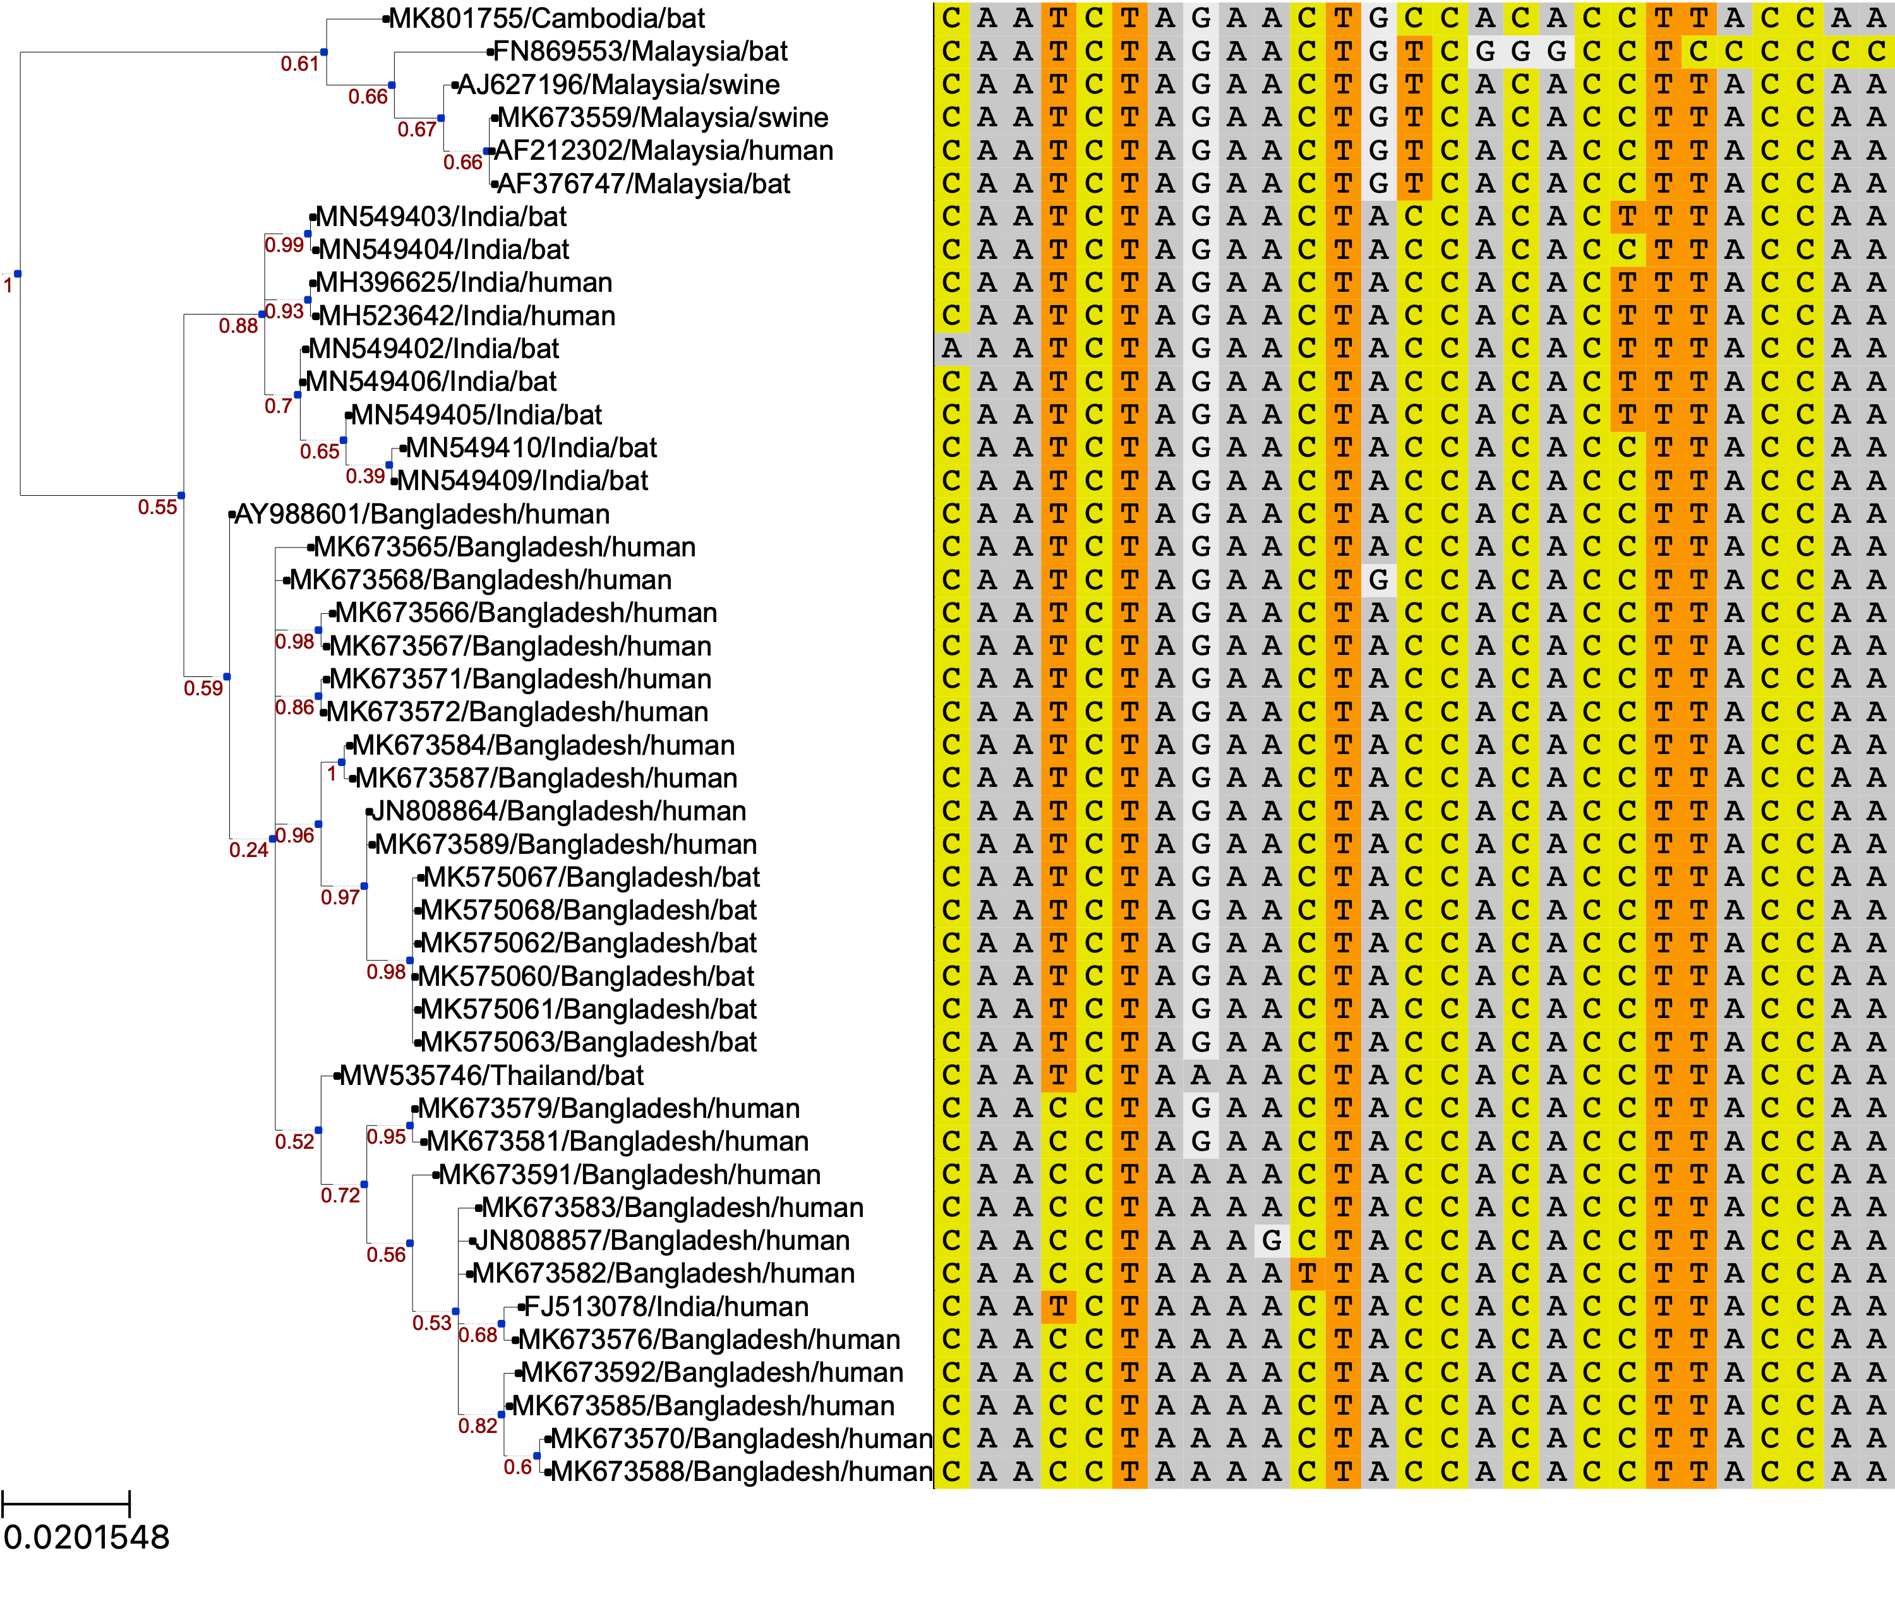
Codons under Positive Selection
58 64 228 377 380 408 421 437 438
Malaysia
India
Bangladesh
Notes:
FEL also identified site 380
Not sure how to use the Empirical Bayes Factor to help with analyses. Provides a confidence measure of whether diversification occurred in a given branch? The paper seems to mention EBF values > 1, but the table outputs proportions between 0 and 1.

Slide 4
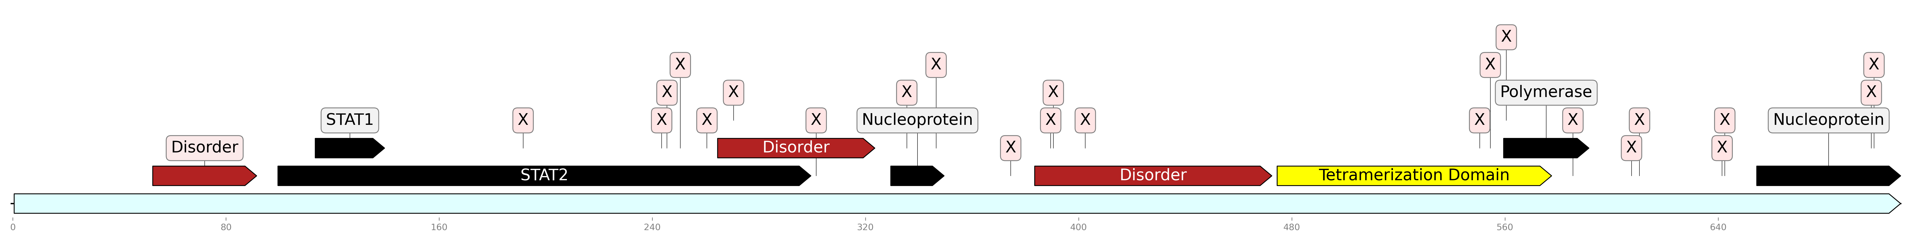
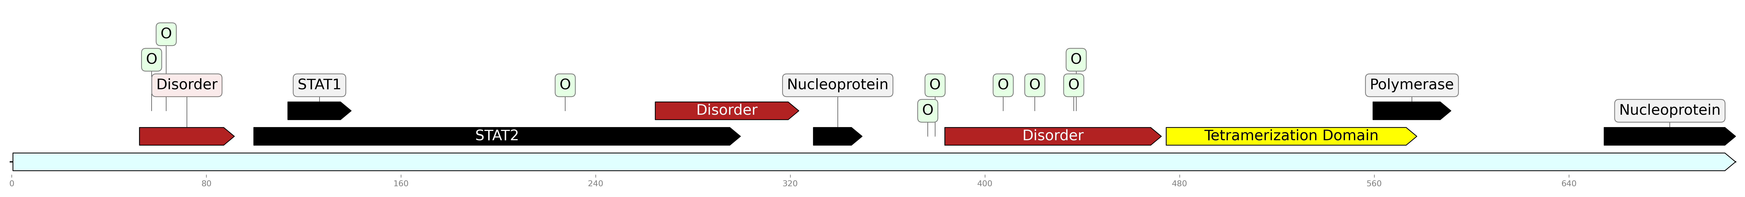
Sites under Positive or Negative Selection
22 Sites under negative selection, p ≤ 0.1
9 Sites under positive selection, p ≤ 0.1

Slide 5
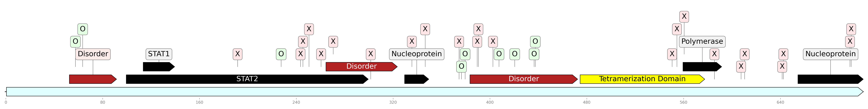
Sites under Positive or Negative Selection
No phosphoprotein structures available for the region AA 51-470
Notes:
Combined

Slide 6

aBSREL branch with diversifying selection
Malaysia
India
Bangladesh

Slide 7



Sites with different dN/dS Rates: Bangladesh vs. Malaysia
Also positive selection
1 additional site when separating Indian isolates
Notes:
Positions 408, 437, 438 overlap between Contrast FEL and positive selection. All in the 3rd disordered region.

Slide 8
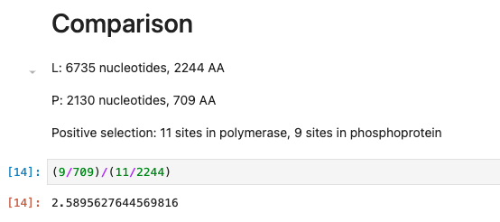
Comparison to Polymerase Protein

Slide 9
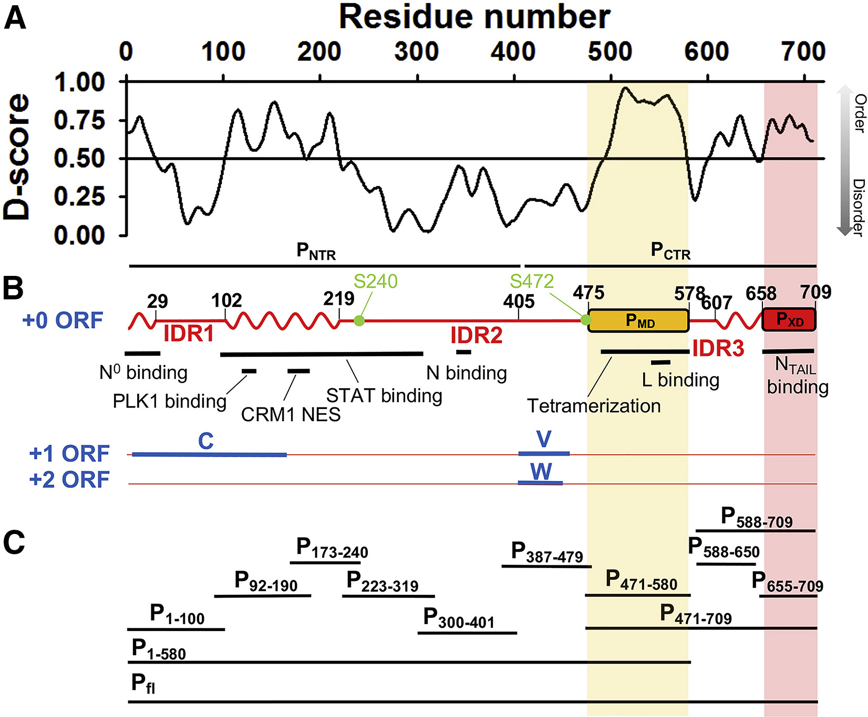
Jensen et al., Biophysical Journal, 2020
Notes:
Intrinsically disordered proteins may allow more mutations (diversifying selection) because structure isn't very constrained. BUT intrinsically disordered viral proteins also tend to bind a lot of other proteins. It's like both things at once -- constrained for binding, but unconstrained structurally.
Look at short proteins in evolutionary selection. If you have small proteins and small datasets, can you find anything? Look at some papers.

